Slide 1
Surface Crack Classification – NEU Dataset

Slide 2
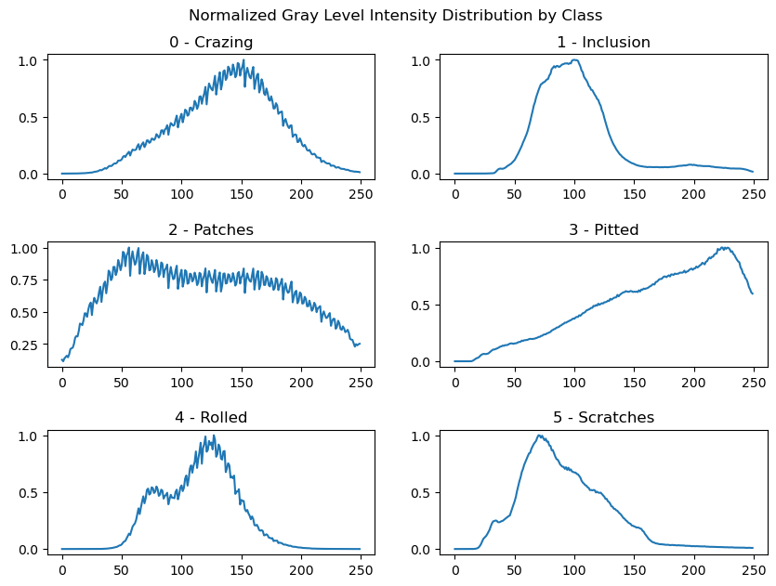
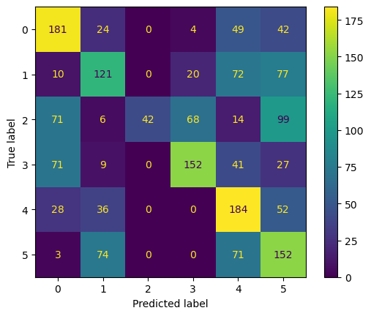
Normalized Pixel Intensity per Class

